Slide 1


























2026: Are climate extremes becoming the new norm?
Clues from the 2025-26 Dry Season CariCOF climate outlooks
Coordination: Dr. Cédric Van Meerbeeck & Dr. Teddy Allen
Participating countries and territories:
Antigua & Barbuda, Aruba, Bahamas, Barbados, Belize, Cayman Islands, Cuba, Curaçao, Dominica, Dominican Republic, French Guiana, Grenada, Guadeloupe, Guyana, Haïti, Jamaica, Martinique, Puerto Rico, St. Barth’s, St. Kitts & Nevis, St. Lucia, St. Maarten/St. Martin, St. Vincent & the Grenadines, Suriname, Trinidad & Tobago and the US Virgin Islands
2024 Dry Season Caribbean Climate Outlook Forum
Gros Islet, Saint Lucia, November 28-29, 2024

Slide 2
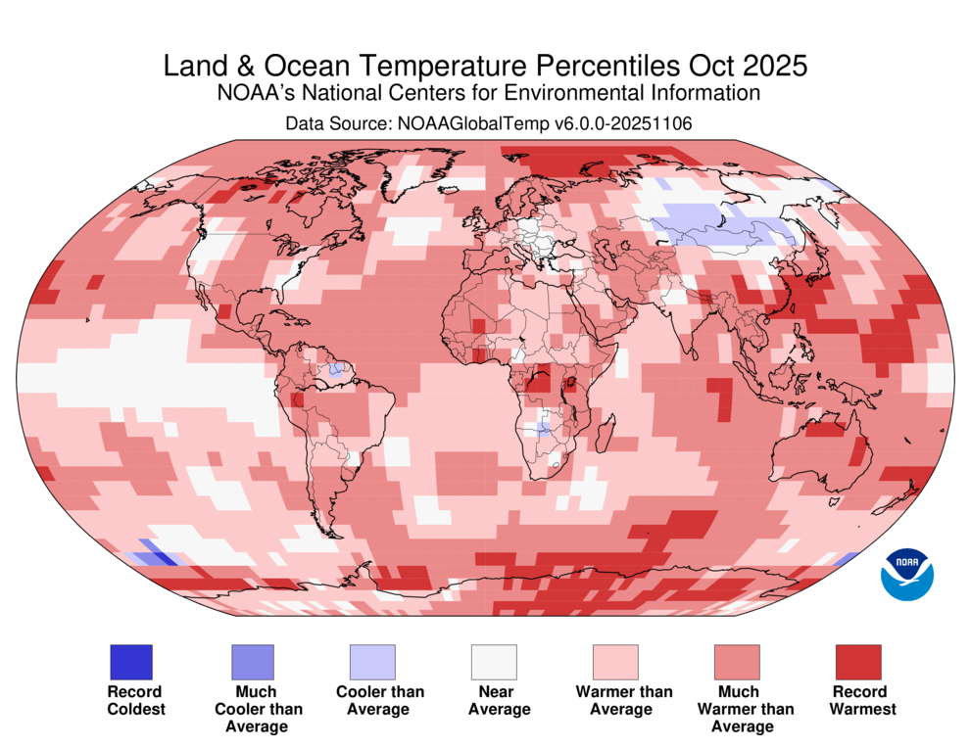
Caribbean Dry Season 2025-26
Different ocean conditions to the historical norm?
Tropical Pacific:
ENSO NEUTRAL
possibly
transitioning
into a weak
LA NIÑA
Tropical
North Atlantic
&
Caribbean Sea:
much warmer
than average

Slide 3
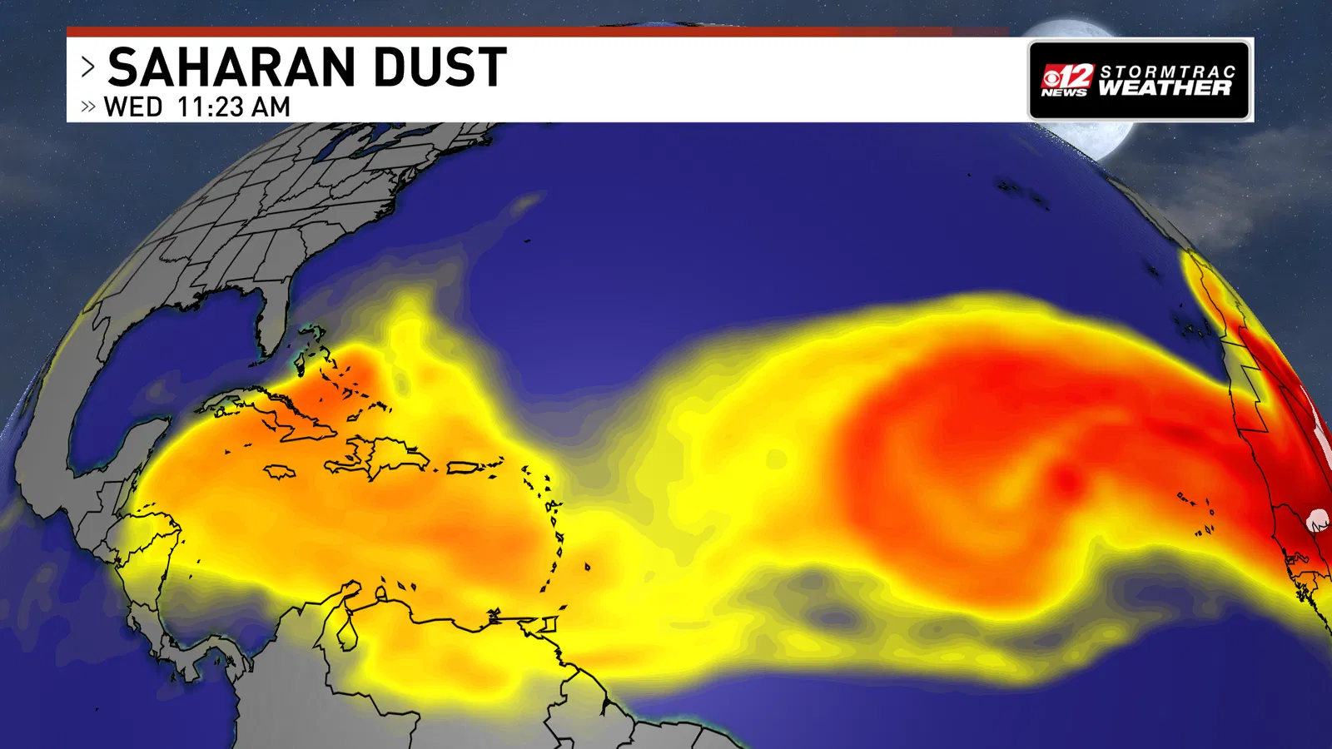
Caribbean Dry Season 2025-26
What we do not know yet ahead of the season…
El Niño is shifting to La Niña + (near-) record warm North Atlantic = excessive heat in the ocean
↔ how often will dry, Saharan Air Layer (SAL) intrusions stifle shower activity in late Dry Season?

Slide 4
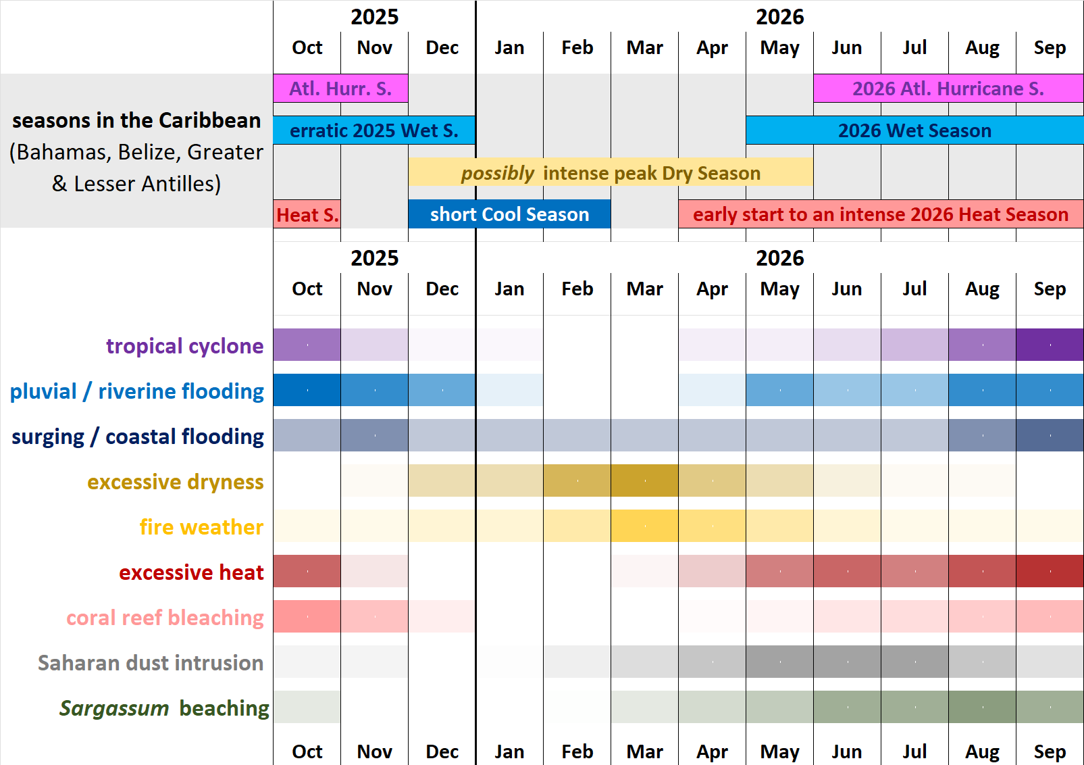
Caribbean Dry Season 2025-26
The scenario for the Caribbean

Slide 5
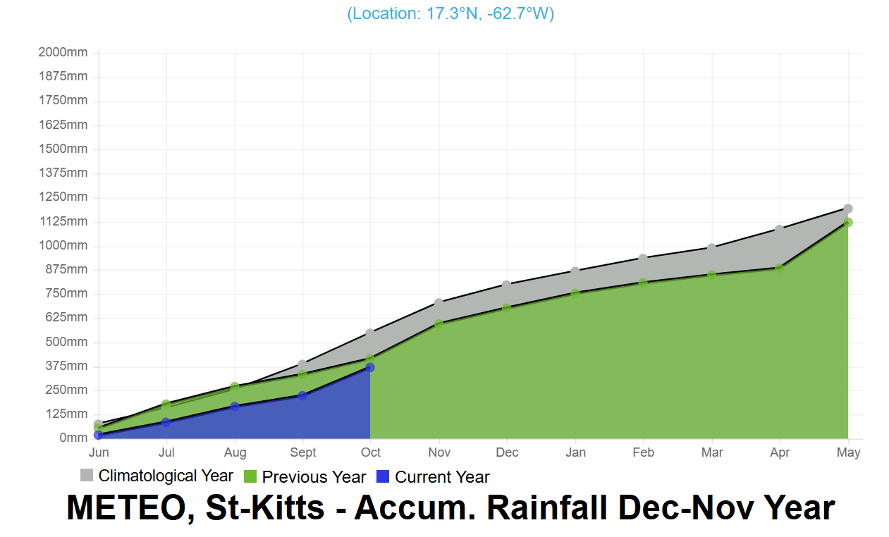
Historical average
June to October this year

Slide 6
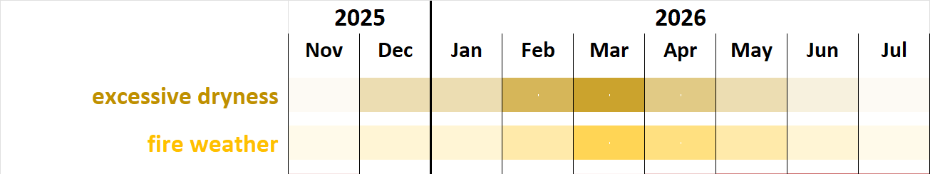
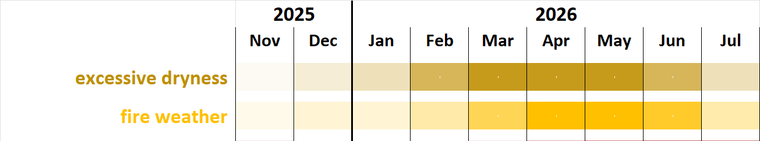
Caribbean Dry Season 2025-26
HOW DRY?
Scenario: usual frequency of SAL intrusions
  Potentially intense peak of the 2025-26 Dry Season
  accelerated depletion of surface water reservoirs and reduced river discharge
  increase in wildfire potential towards March, particularly in areas affected by drought
Alternative scenario: very frequent SAL intrusions
  more dry spells & worsening drought towards May
  slower drought alleviation after May
  slow decrease in wildfire potential

Slide 7
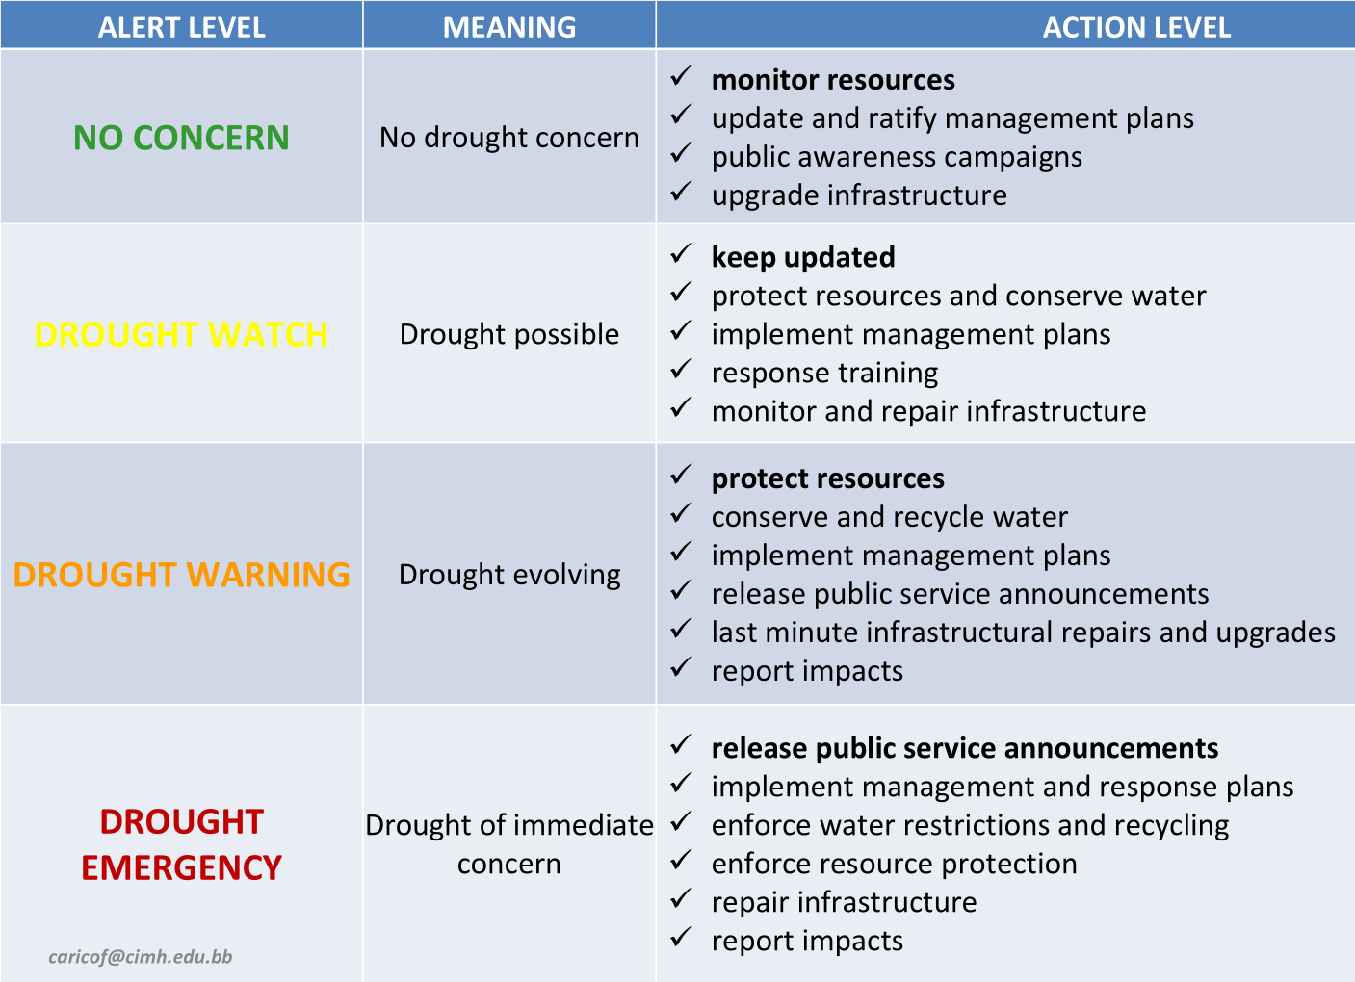
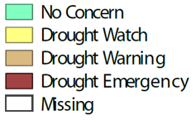
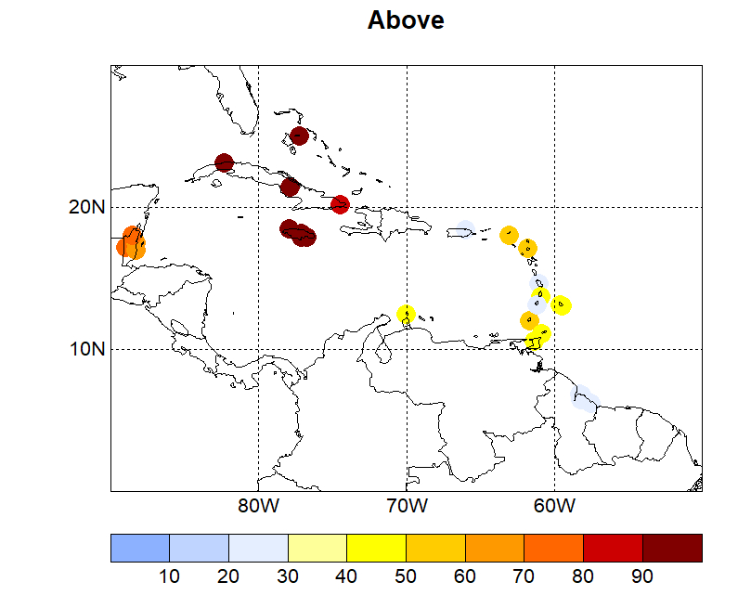
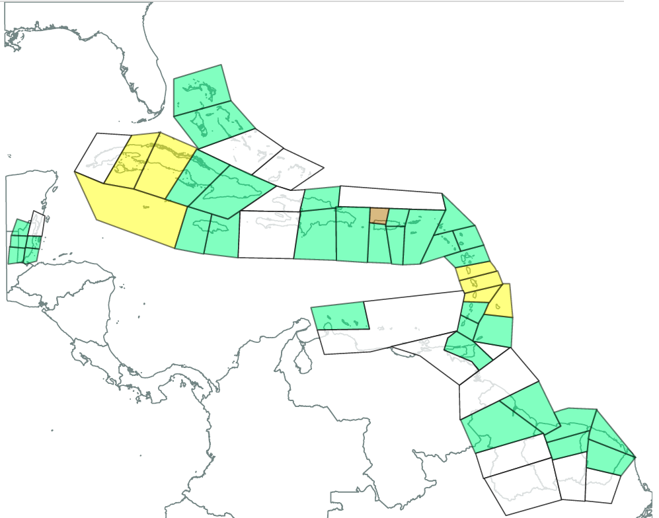
HOW DRY?
Short-term drought by the end of Feb. 2026 in pockets of the region
Short term drought alert levels
at the end of February 2026
Probability of at least three
7-day dry spells
Dec. 2024 to Feb. 2025

Slide 8
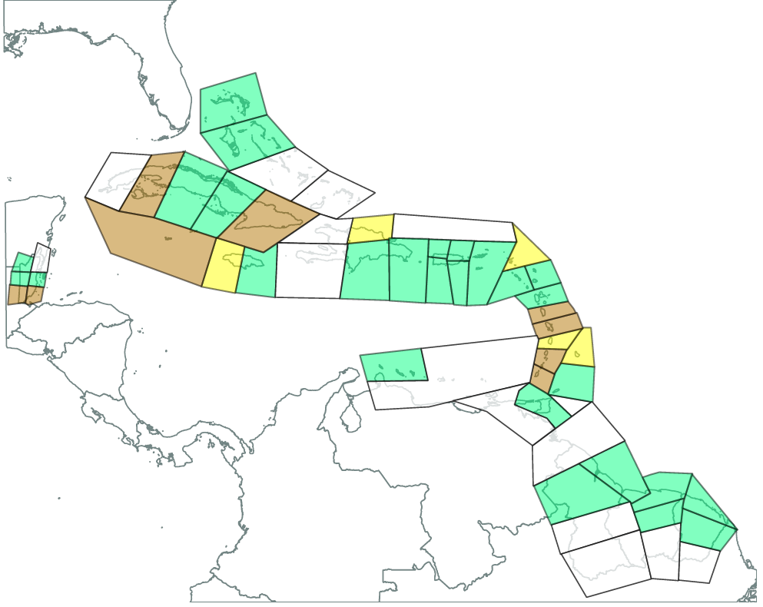
HOW DRY?
Long-term drought concern at the end of May 2026 in several areas
Long term drought alert levels
at the end of May 2026

Slide 9
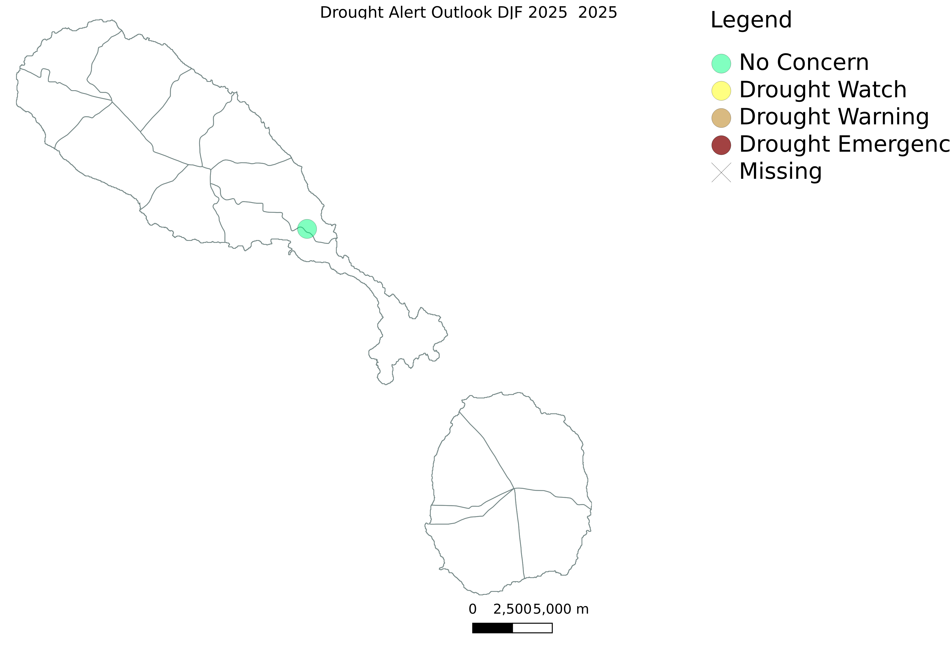
Short term drought concerns by the end of February 2026
Long term drought concerns by the end of May 2026

Slide 10
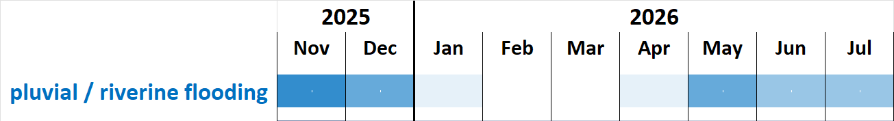
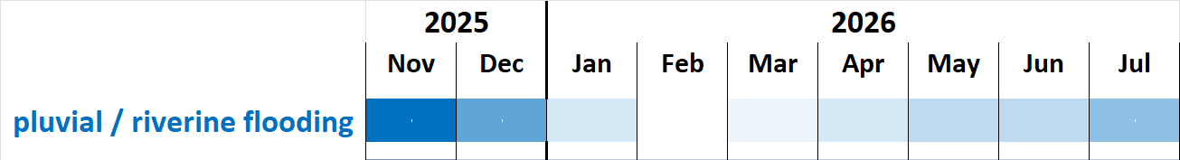
Caribbean Dry Season 2025-26
HOW WET?
Scenario: usual frequency of SAL intrusions
Wet through December, except in the far northwestern Caribbean
Frequent & intense rains through December, resulting in high potential for flooding, flash floods, cascading hazards & impacts.
Frequent rains in the southeast are conducive to moisture-related pests.
Alternative scenario: very frequent SAL intrusions
erratic, intense wet spells from May to July.

Slide 11
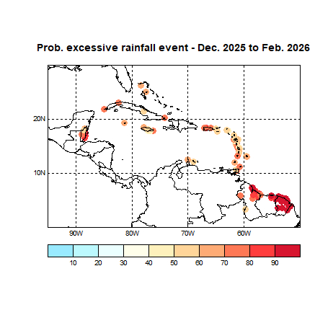
Flash flood potential associated with excessive rainfall* from December 2025 to February 2026
Flash flood potential | Colour codes | Probability of excessive rainfall* event
extremely high |  | >80%
high |  | 50-80%
moderate |  | 20-50%
slight |  | 10-20%
marginal |  | 0-10%
* excessive rainfall is defined here as at least 30 mm of rainfall within a 24-hour period
FORECAST: Extremely high flash flood potential in the Guianas (except for southwest Guyana); high potential in
Aruba, Belize, most mountainous areas and larger islands in the Greater and Lesser Antilles; moderate
potential in Curaçao, southwest Guiana and in most other areas of the Antilles.

Slide 12
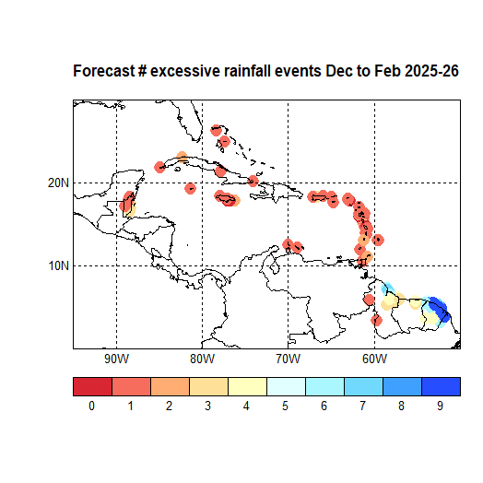
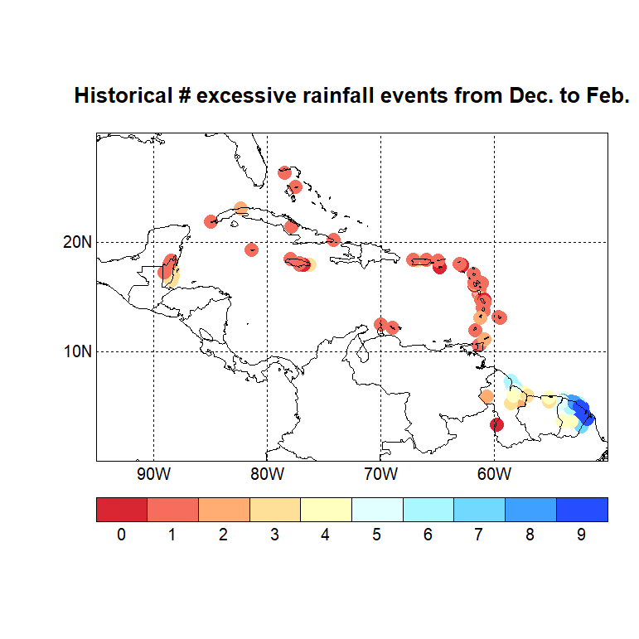
Number of excessive rainfall events* that could trigger flash floods from December 2025 to February 2026
* excessive rainfall is defined here as at least 30 mm of rainfall within a 24-hour period
or more
or more
Historical avg.: Coastal Guianas at least 4 excessive rainfall events; southeast Belize, interior of the Guianas, far eastern
Jamaica 3 or 4 events; northwest Belize and the Antilles up to 2 events; southwest Guyana
and St. Croix up to 1 event.
FORECAST: Slight increase from the avg. number of excessive rainfall events in the Coastal Guianas (medium
confidence), but no significant change from the usual number elsewhere (low to medium confidence).

Slide 13
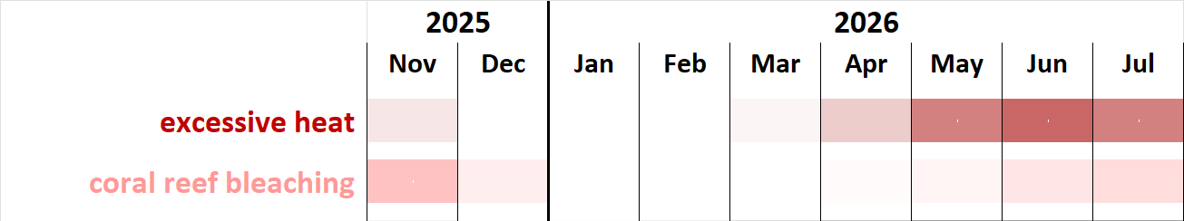
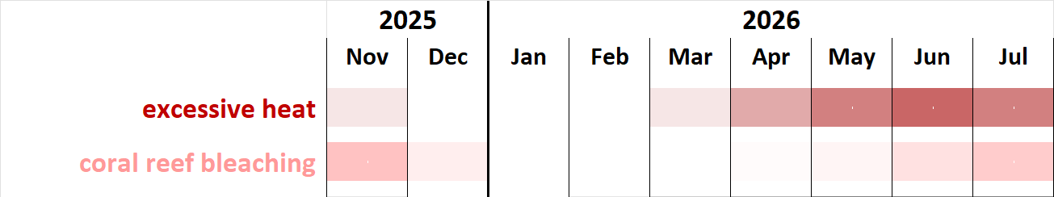
Caribbean Dry Season 2025-26
MILD or HOT?
Scenario: usual frequency of SAL intrusions
Cool Season between Dec. & Feb., followed by early start of an intense Heat Season:
warmer nights and days than usual, yet more comfortable during the Cool Season
frequent and intense heatwaves from May
coral bleaching continuing through December in the far southern Caribbean
heat stress in marine ecosystems decreasing through April across the Caribbean
Alternative scenario: very frequent SAL intrusions
  humid heat becoming intense from April
  prolonged duration of intense marine heatwaves from July

Slide 14
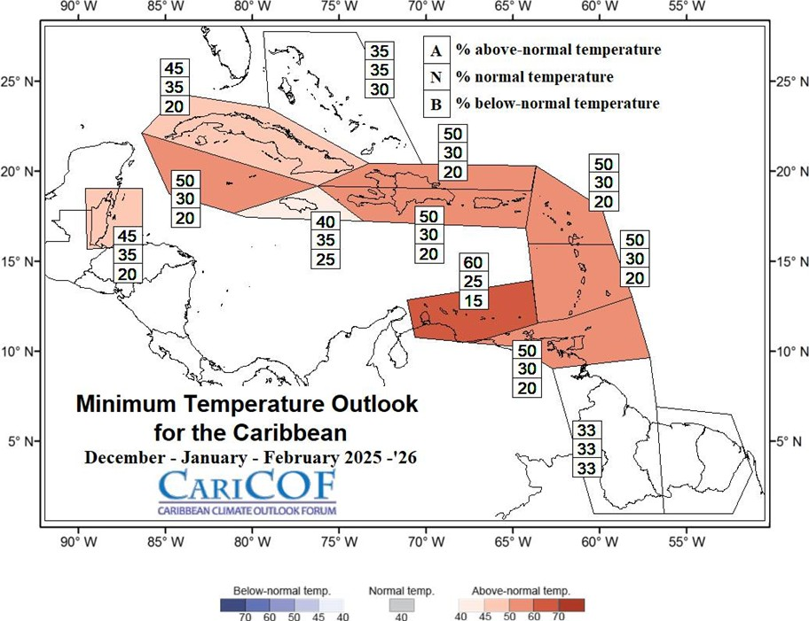
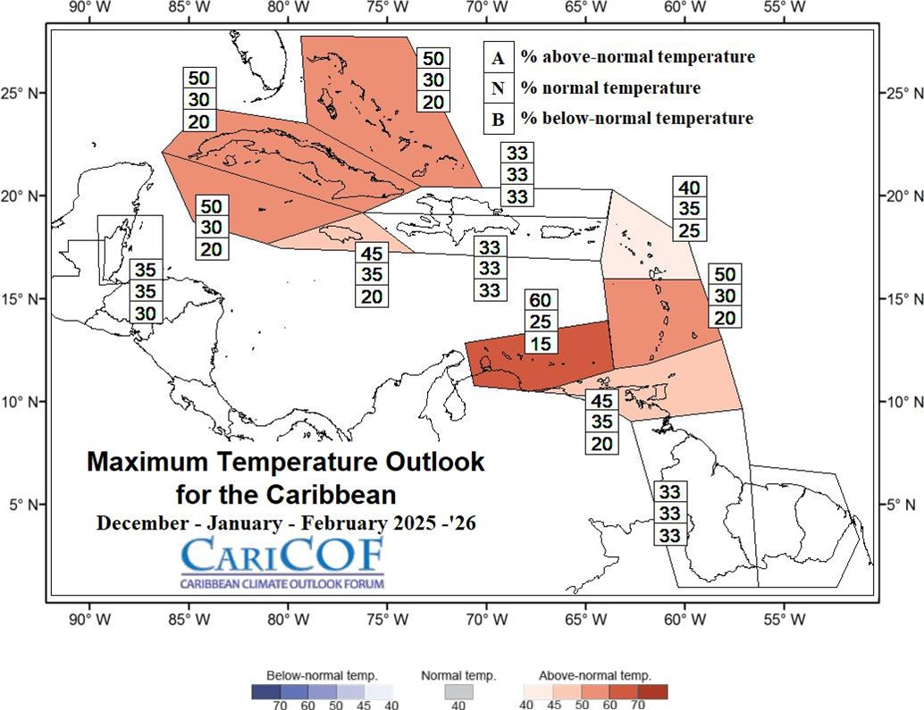
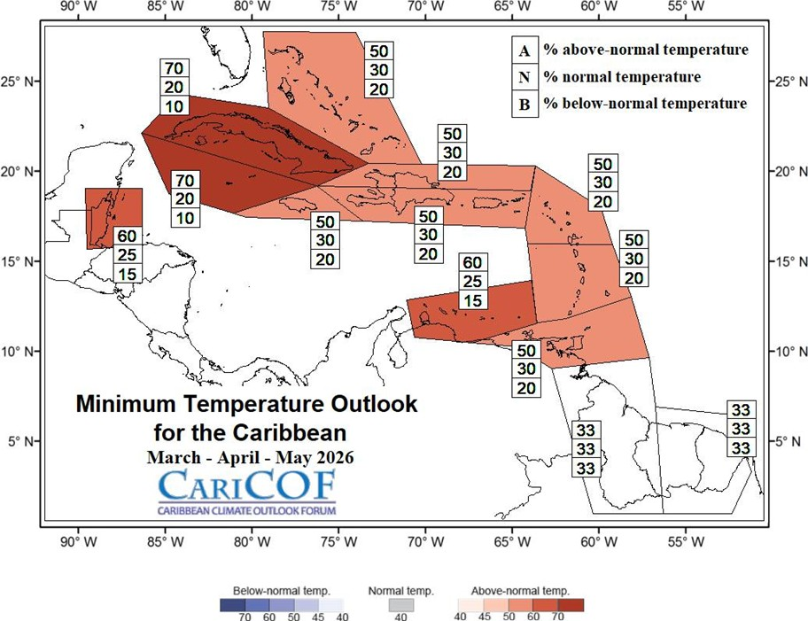
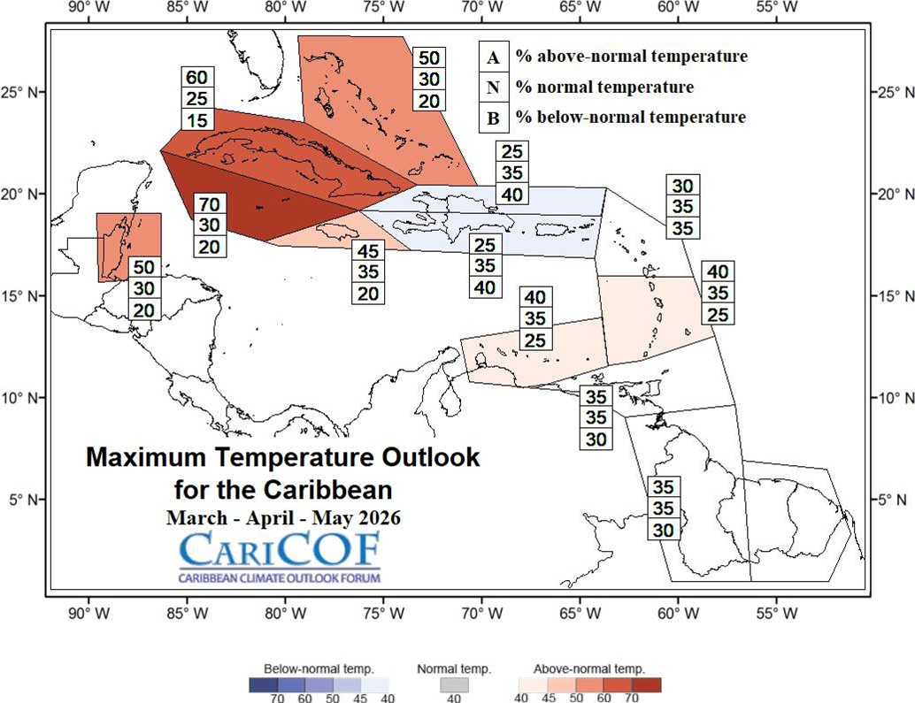
Overall, how hot will the next three to six months be?
Night-time
Daytime
FORECAST
Cool Season (December through February) comes with mostly comfortable temperatures, though still warmer than usual for this season in most areas.
April & May – the transition into the 2026 Heat Season – to feature a rapid warming, except if very wet.
IMPLICATIONS
Low chance of heat stress episodes in the vulnerable population & small livestock until February but becoming increasingly frequent and intense in April and May.
Heat waves are increasingly likely in April and May.
Dec-Jan-Feb 2025-26
Mar-Apr-May 2026
Milder Usual Hotter

Slide 15

Thank you
For Caribbean climate monitoring information, climate outlooks and climate bulletins, please visit:
rcc.cimh.edu.bb
Additional regional early warning tools are found at www.cimh.edu.bb

